Slide 1
SI 501 F21: Week 7 Agenda
Background Research Report revisions
Affinity walls
Video
Demonstration
Discussion
Exercise
Team affinity wall

Slide 2
Background Research Report Revision
Opportunity to revise and resubmit: Due Nov. 15.
If you resubmit, please include another cover sheet explaining what changes you made.
Use “track” mode or different colored font for your revisions.
You’re eligible to make up 75% of the score you didn’t receive.
For example, if you scored an 80/100 this time (missing 20), 75% of 20 points is 15 points, so if you handed in an excellent revision, your final score would be 95.
You are encouraged to resubmit if you scored a 92 or less.
If you do resubmit, however, please take the revision seriously. It requires additional effort on our part to grade.
Any points you lost for lateness cannot be made up.
For example, if you scored a 75/100 of which 5 points was taken off for lateness, then the 5 points stays off regardless of revision. Of the remaining 20 points, you can make up up to 75%, or 15 points.
The grading comments should point you in the right direction. And as usual, we are happy to provide feedback in advance.
Don’t hesitate to ask your instructor/GSIs for additional input.

Slide 3
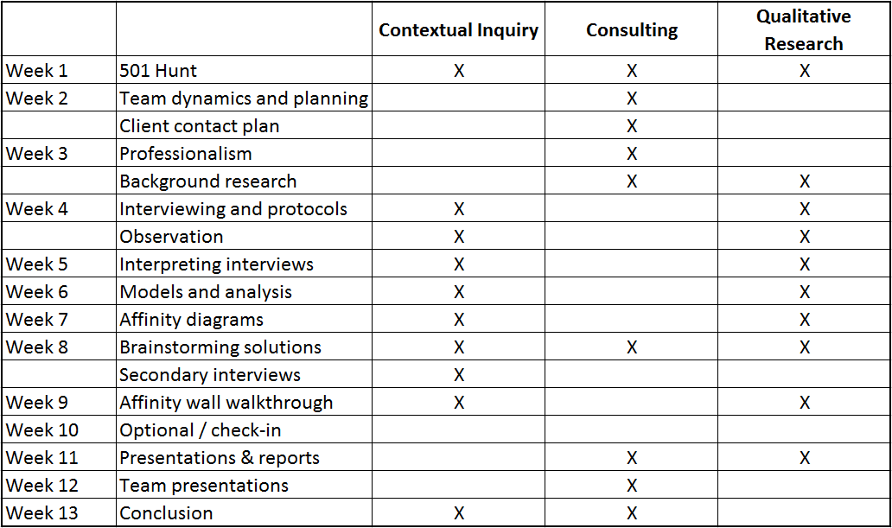
Course Overview

Slide 4
[Affinity Wall Video]

Slide 5
Miro demo

Slide 6
[W01] In low-SES school: Computers more likely to be down.
[W01] In high-SES school: Students randomly pull content from websites.
[Student01] “I learned how to change fonts on the computer.”
[P03] Maine spent budget and effort on integrating laptops into curriculum and training teachers.
[D02] Finnish school system is low-tech.
[W01] In low-SES school, more students struggling with literacy.
[Teacher01] “I have to write 2 lesson plans: 1 w/the PC and 1 w/o, in case of tech problems.”
[Student01] “I like the classes that we use computers in.”
[P03] South Korea scores high on PISA tests of student achievement.
[D02] South Korean school system is high-tech.
[W01] Overall, less literate students had more difficulty with computer tasks.
[Teacher02] “I don’t have time to prepare PowerPoints for each class.”
[P03] The 1-to-1 laptop program in Maine showed significant gains in learning.
[W01] In low-SES school: Teacher graded students for use of different fonts in PowerPt.
[P03] Finland consistently scores at the top of PISA tests of student achievement.

Slide 7
Technology is a difficult intervention in education.
Technology in education is not easy to get right.
Technology may not necessarily be a contributor to learning outcomes.
Low SES schools struggle with making best use of computers.
Teacher preparedness allows for better use of laptops.
Students’ learning of technology may not be contributing to educational learning.
High-tech/low-tech may not be differentiator in learning outcomes.
[Teacher01 Low-SES] “I have to write 2 lesson plans: 1 w/the PC and 1 w/o, in case of tech problems.”
[W01] In low-SES school: Computers more likely to be down.
[P03] The 1-to-1 laptop program in Maine showed significant gains in learning.
[P03] Maine spent budget and effort on integrating laptops into curriculum and training teachers.
[Student01] “I like the classes that we use computers in.”
[Student01] “I learned how to change fonts on the computer.”
[P03] Finland consistently scores at the top of PISA tests of student achievement.
[P03] South Korea scores high on PISA tests of student achievement.
[W01] In low-SES school, more students struggling with literacy.
[W01] Overall, less literate students had more difficulty with computer tasks.
[Teacher02] “I don’t have time to prepare PowerPoints for each class.”
[W01] In low-SES school: Teacher graded students for use of different fonts in PowerPoint.
[W01] In high-SES school: Students randomly pull content from websites.
[D02] South Korean school system is high-tech.
[D02] Finnish school system is low-tech.

Slide 8
Discussion What kind of thinking do you need to do? In what parts of the affinity wall building process does the thinking happen? What are you really doing in an affinity wall? What kind of “data” does it work for? What other contexts could it work in?

Slide 9
The One Big Secret to Doing a Good Affinity Wall! What you write in the BLUE and PINK NOTES (the middle two layers) is the most critical, and it requires careful thinking. In these notes, compress all the interesting content in the cluster of notes they represent, and write it as a single, complete statement. Try to write something that is…
Accurate;
Standalone – someone not familiar with the yellow notes should be able to understand the overall point;
Comprehensive – it should capture the content in all of the yellow notes beneath it;
Precise – it should be as specific and meaningful as it can be, while being all of the above; it will often call out a pattern/trend in the cluster of notes.

Slide 10
Other Secrets to a Good Affinity Wall
There are multiple ways to “correctly” create clusters and label them. Don’t agonize too much between what seem like two equally good ways.
It’s not a good sign if you have too many yellow clusters that are composed of notes from one interviewee only.
It’s OK to have clusters that contain contradictory statements – a blue note may say, “Within the organization, there are strong, contradictory views about whether X is good for Y.” That’s also revealing.
Each team should expect to have about 120-360 yellow affinity notes. (More if you did more than 6 hours of interviews.) It will probably take you 6-12 hours to create the completed affinity wall, working as a team.
Don’t worry about how the wall looks until the end, when you’re pretty sure you have good clusters and good blue, pink, and green notes. Then, rearrange, so that it looks nice and is easy for viewers to understand.
Green notes may be loose themes clustered together, without a single summarizing assertion.

Slide 11
Questions?

Slide 12
Affinity Wall Exercise 1 Work with your team, using affinity notes from the website/app exercise we have been doing in class. Spend 20-30 minutes building one small affinity wall, using all of the interpretation notes that you have as a team. Do something similar to the demo you just saw. For reference, look at the Affinity Wall Instructions document. If you didn’t receive an email invitation to Miro, or can’t log in, try this link: https://j.mp/si501f21miro . (If Miro asks you to create an account, use your umich.edu email)

Slide 13
Discussion How did it go? Was there anything that was tricky or difficult to do? Did you argue about the right way to cluster?

Slide 14
Affinity Wall Exercise 2 Work with another team (https://j.mp/si501f21swap). Spend ~5 minutes to explain your affinity wall and analysis to the other team. The other team should ask questions for another 5 minutes. After ~10 minutes, swap roles. (Total time for this exercise is ~20 minutes.) When doing this, try to understand the other team’s analysis. If they have written good blue/pink notes, it will be much easier. Throughout, ask the question, “What commonalities are there across difficulties that people experience with different websites/apps?”

Slide 15
Discussion Were any of your conclusions similar? Did you notice anything different about the other team’s affinity wall? Did you learn anything from the other pair? Any questions about affinity walls?

Slide 16
Qualitative Data Analysis = Intelligence ?
Clustering and summarizing is the same as finding patterns.
Seeing patterns allows you to remember more things with less memorizing effort.
If the patterns and summaries are meaningful ones – that is, if they are based on underlying causes and correlations, and not just on coincidence – they will also help you know more things and predict more things with less effort.
Affinity walls are a systematic way to identify patterns in a large amount of heterogeneous information.

Slide 17
Team Meetings with Kentaro (Nov. 8-19)
Required for each team…
I want to get a sense for where your analysis is, and provide feedback. You do not need to prepare anything formal. The work you do on your affinity wall (due before the meeting) is enough preparation.
To schedule:
Go to http://j.mp/toyamaUMcal. That will take you to Kentaro’s Google calendar appointment slots.
Navigate to the weeks of Nov. 8 and 15, where you should see 20-minute appointment slots marked “SI 501 team meeting.”
Pick one slot with your team (try to pick a time when everyone can attend), click on the link, insert under “Description” your team code (i.e., “001X”), team members’ names, client name, and 1-2-sentence description of the client problem. Submit the form.
Sign up early, so that you have more slots to choose from!

Slide 18
Coming up…
Annotated Interview Notes due next week (Nov. 1).
No readings and no quiz this week!
Complete interviews and interpretation sessions as soon as you can.
Once you’ve done 4 or more interviews, you can start affinity walls for your client projects.
Your final affinity wall will be due by the beginning of class Nov. 8 (two weeks from today). That day, you will share/discuss your affinity wall with classmates, so you must be done with the affinity wall.

Slide 19
Discussion Section Today
Open time for working with your team – you can use the time for interpretation sessions, to start your affinity wall, or to start your Annotated Interview Notes assignment.
Your GSI will check in with you to see where you are with interviews, etc.

